Slide 1
FTC Robot Parts, Do & DON’Ts Mike Sonnier mike@sonnier.name September 2018

Slide 2
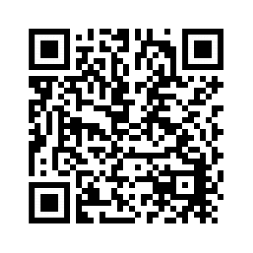
Downloads and info
This presentation and other resources may be found at:
https://goo.gl/gxCHd7

Slide 3
Material Liberally Borrowed From
2017 West Michigan FTC Kickoff -- http://ftckickoff.allendalerobotics.com/wp-content/uploads/2017/09/2017-Allendale-Robotics-FTC-Components-and-Tips.pdf
AndyMark Education Presentations -- http://www.andymark.com/category-s/508.htm

Slide 4
About Me
BSEE/MSEE Computer Engineering
Build Mentor: FRC Team 2992 SS Prometheus – 2013-2018
Build Mentor FTC Team 8891 SS Epimetheus – 2014-2016
Build Mentor FTC Team 10337/14374 Dark Matter – 2015-2018
Certified FRC Robot Inspector
Certified FTC Field Technical Advisor, Control System Advisor, Lead Robot Inspector

Slide 5
Topics
Robot Systems
Robot Mechanical Components
Robot Electrical Components
Build Do’s and Don’ts
Q&A

Slide 6
Disclaimer
This presentation only highlights my opinion on key points of the Part 1 manual on components and build rules. It does not relieve your team of the responsibility to read and question the rules and monitor the FTC forum for rule changes. THIS IS NOT OFFICIAL INFO.
The FTC forums are available at https://ftcforum.usfirst.org/ . This is the only official source for Q&A and interpretations of the game manual.

Slide 7
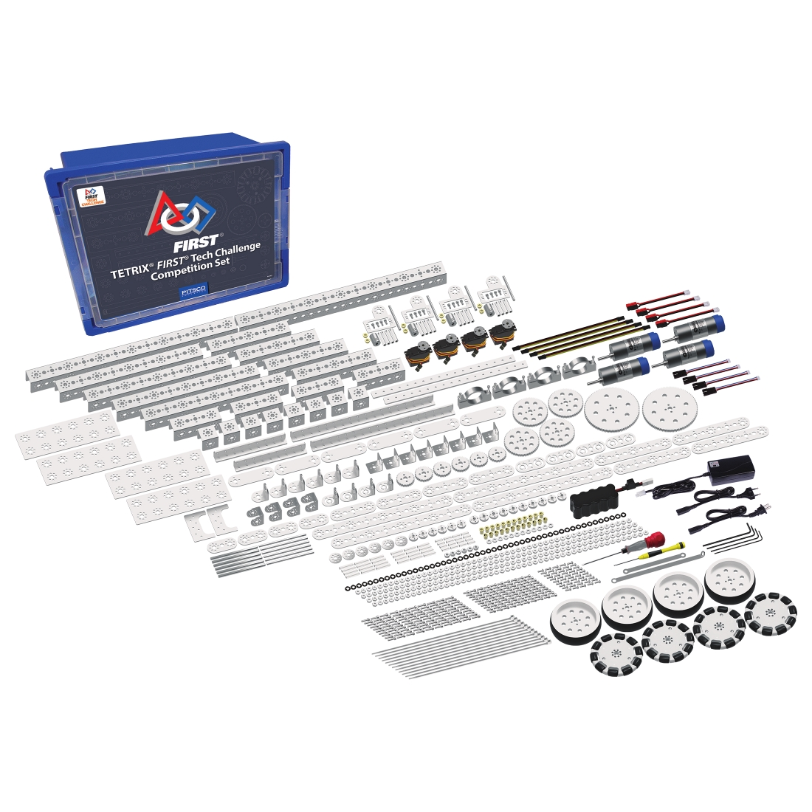
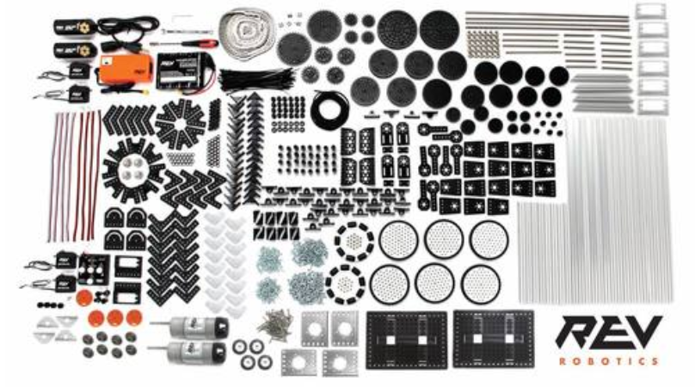
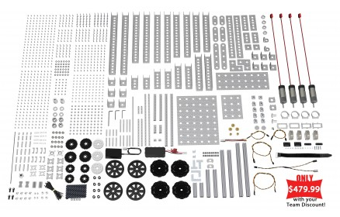
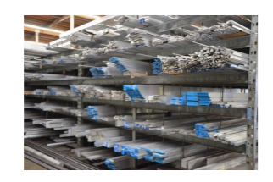
Build Options – Starting Kit Choices
You have choices! Every vendor product has pros/cons! You can mix & match (sometimes with some custom interfacing required).
Custom Built

Slide 8
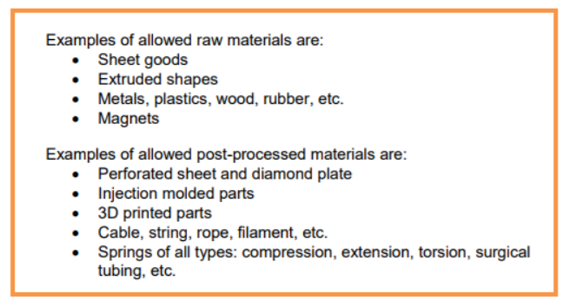
<RM01> Allowed Materials
Teams may use raw and post-processed materials to build their Robots, provided they are readily available to the majority of Teams from standard distributors (for example, McMasterCarr, Home Depot, Grainger, AndyMark, TETRIX/PITSCO, MATRIX/Modern Robotics, REV Robotics, etc.).

Slide 9
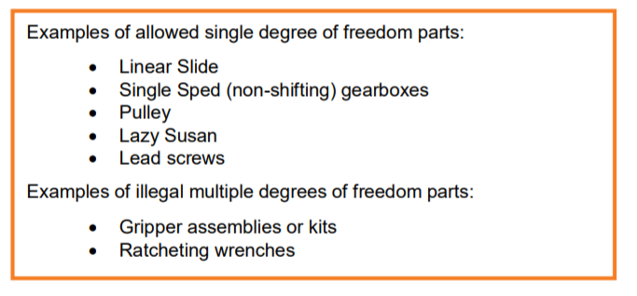
<RM02> Commercial Off the Shelf Parts
Teams may use Commercial Off The Shelf (COTS) mechanical parts that have a single degree of freedom. A single degree of freedom is a system whose motion is defined just by a single independent co-ordinate (or function). It is the intent of FIRST is to encourage Teams to design their own mechanisms rather than purchasing predesigned and pre-manufactured solutions to achieve the game challenge.
COTS drive chassis (for example, AndyMark TileRunner, REV Robotics Build Kit) are allowed provided none of the individual parts violate any other rules.

Slide 10
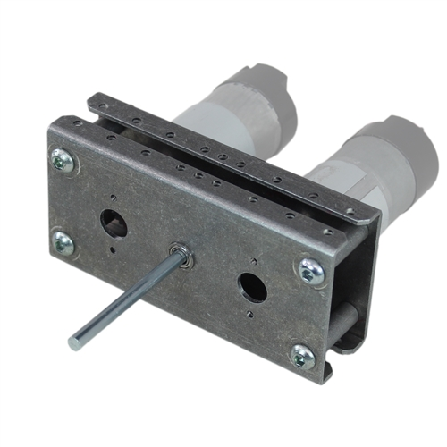
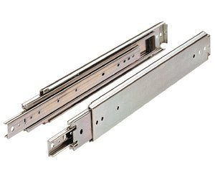
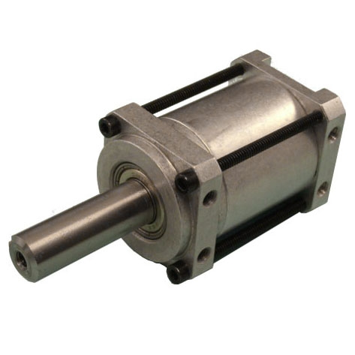
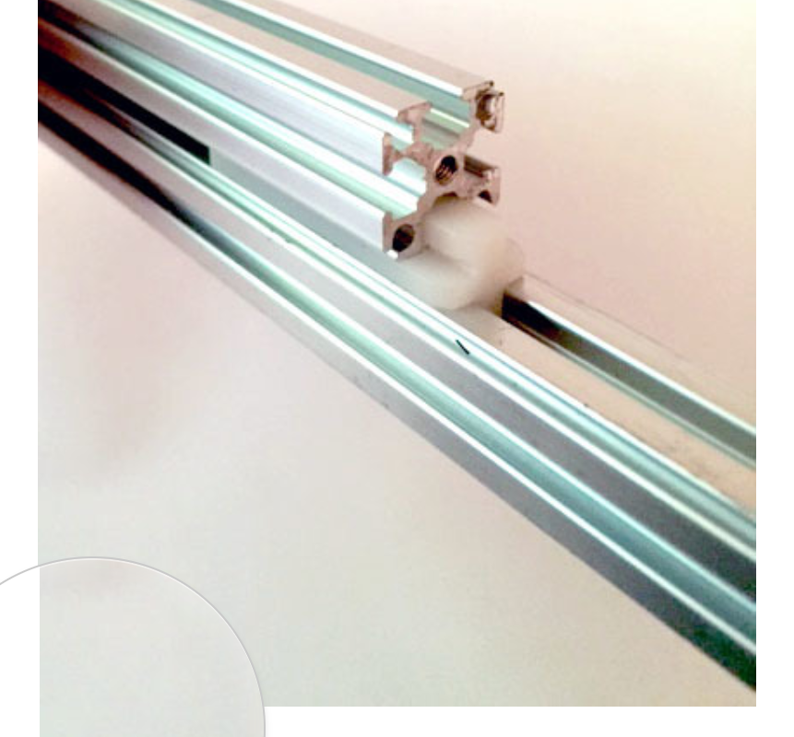
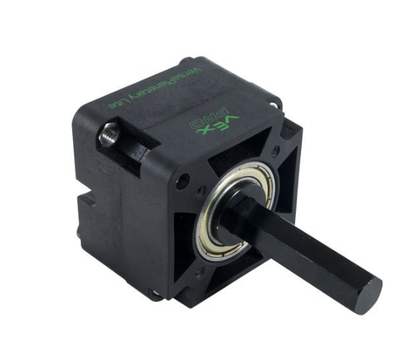
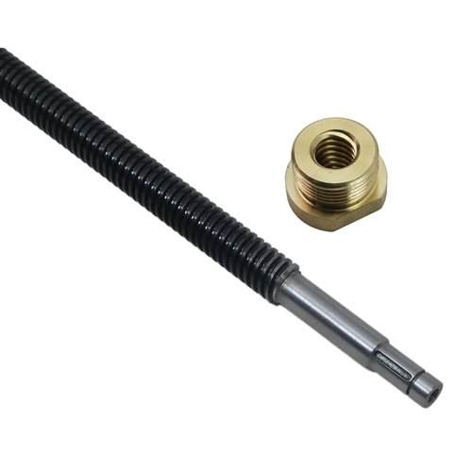
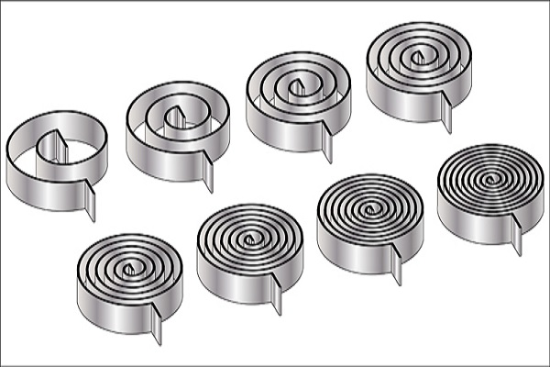
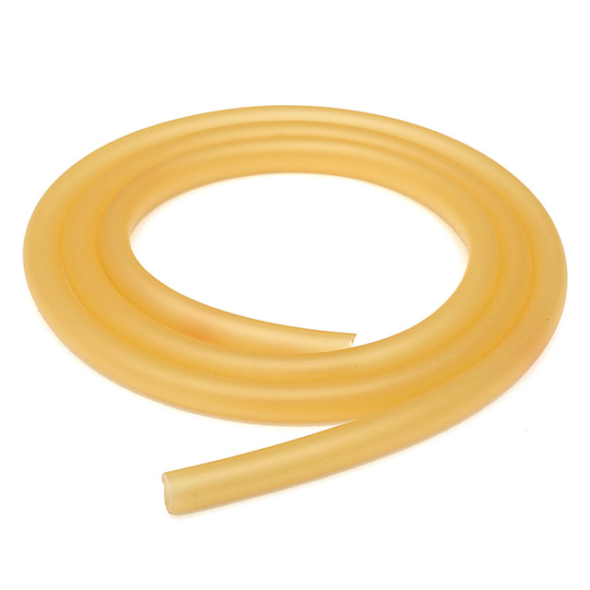
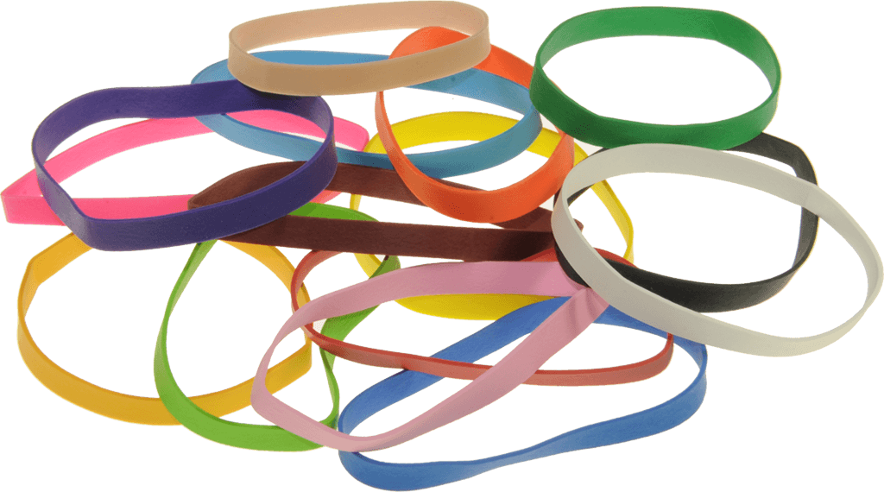
COTS Examples
Single Speed Gearboxes
Linear Slide Kit / Drawer Slides
Lead Screw & Nut

Slide 11
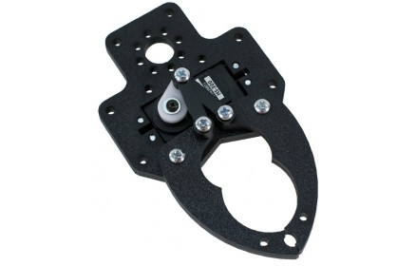
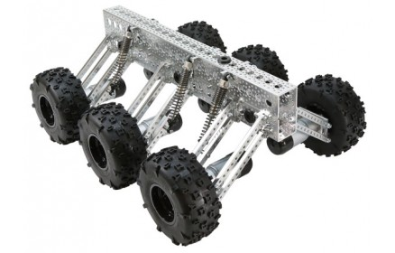
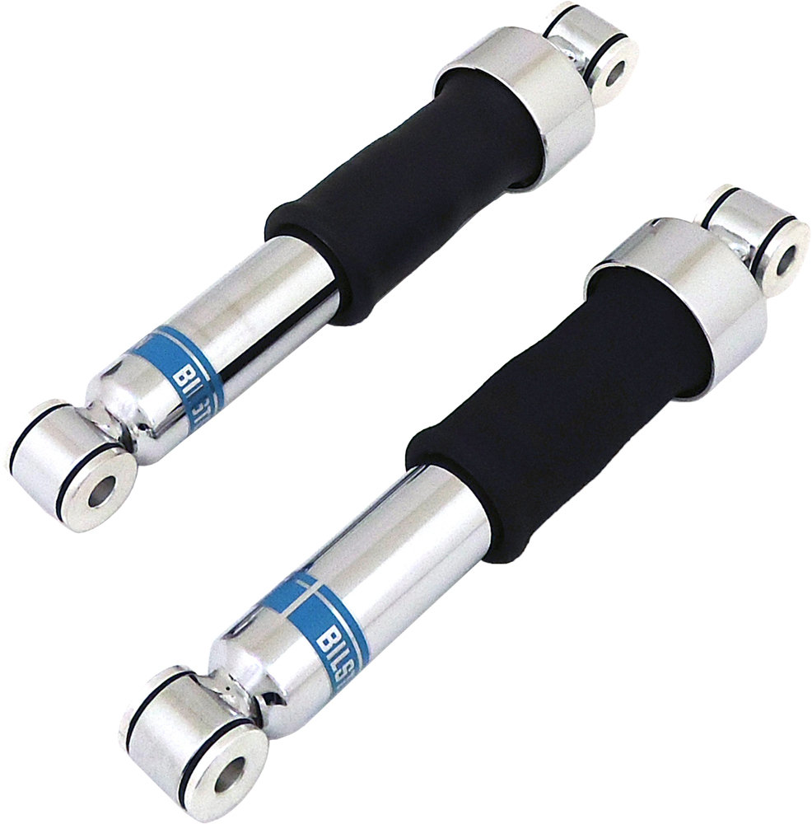
COTS Example No Nos
Gripper Kit (more than 1 degree of freedom)
Articulated Drive Train (more than 1 degree of freedom)
Air Shocks (Stored Compressed Air)

Slide 12
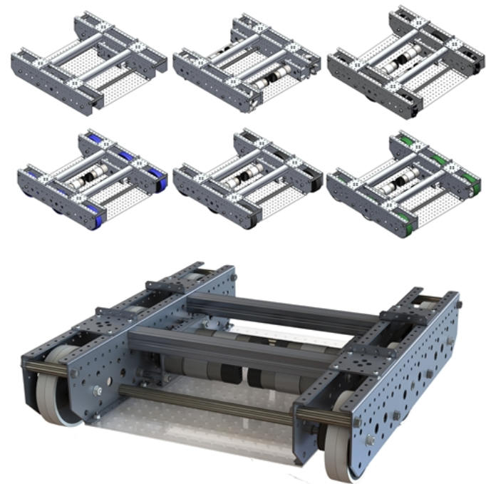
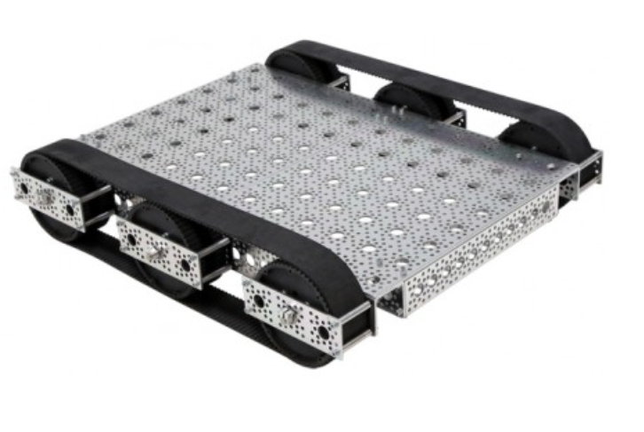
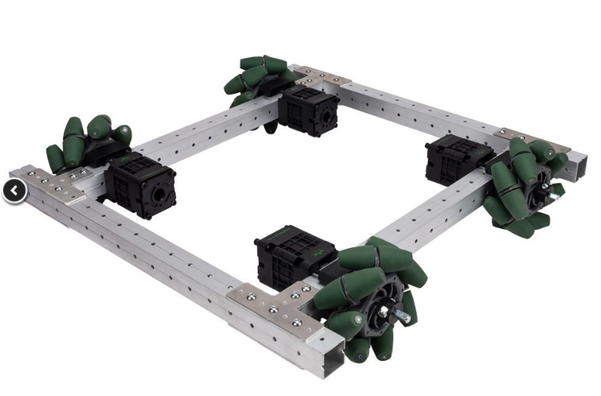
COTS Allowed Drive Chassis Kits
TileRunner
VersaChassis Mini
$550 and up
Includes gearmotors.
$330 and up
Kit motors not FTC legal but can use other motors!
$300 and up
Includes gearboxes but no motors.

Slide 13
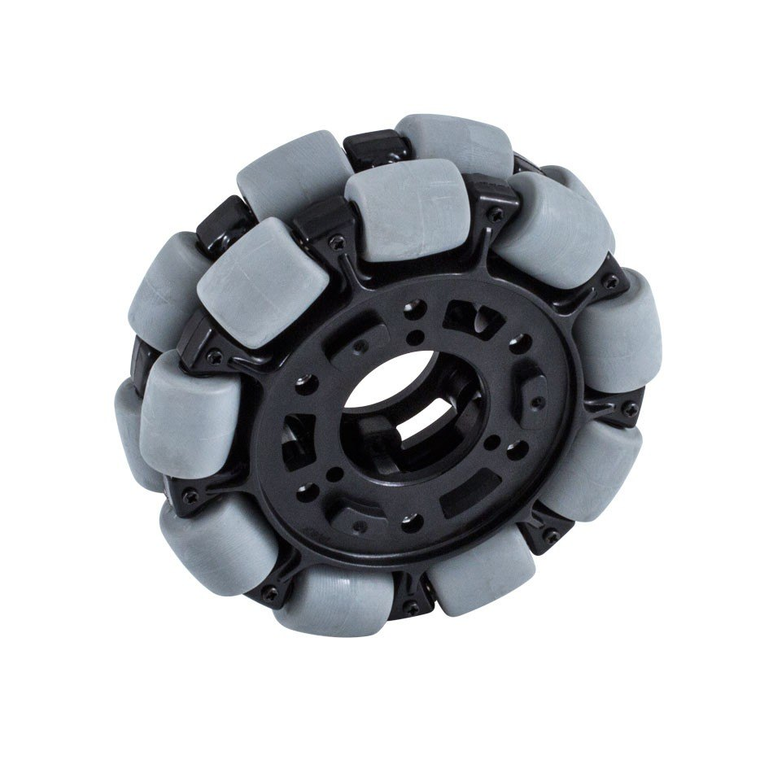
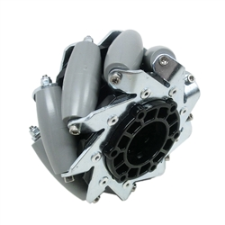
Other Mechanical Rules
<RM03> Holonomic Wheels - Holonomic wheels (omni or mechanum) are allowed.
<RM04> Modifying Materials and COTS Parts - Allowed materials and legal COTS parts may be modified (that is, drilled, cut, painted, etc.), as long as no other rules are violated.
<RM05> Allowed Assembly Methods - Welding, brazing, soldering, and fasteners of any type are legal methods for assembling a Robot.
<RM06> Lubricant - Any type of COTS lubricant is allowed, if it doesn’t contaminate the Playing Field, game elements, other Robots, etc.

Slide 14
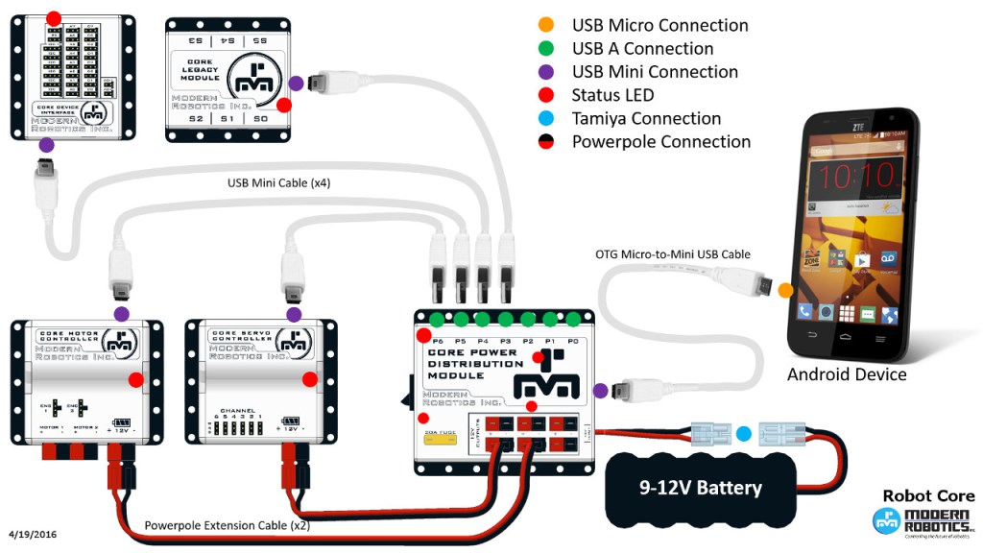
Modern Robotics Control System

Slide 15
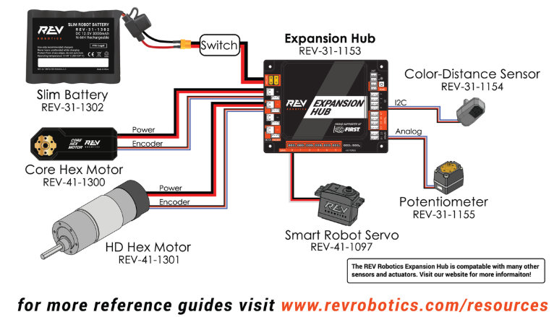
Rev Robotics Control System

Slide 16
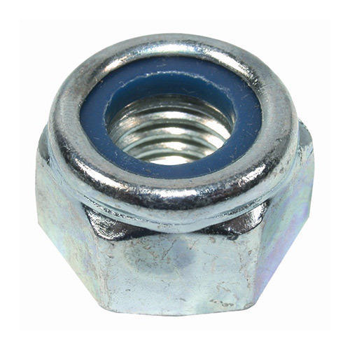
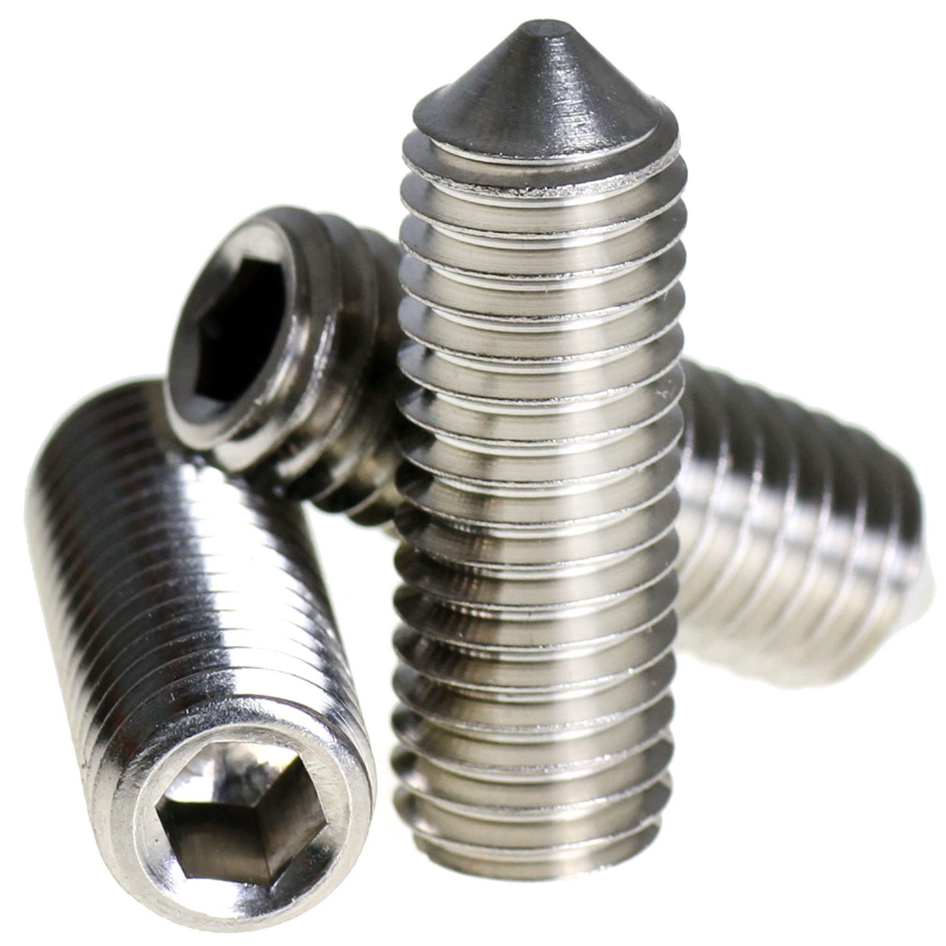
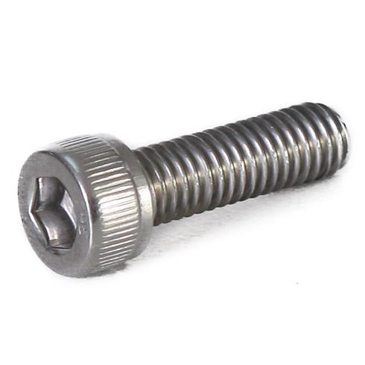
Mechanical Build Tips
Fasteners
Use nylon insert lock nuts (#6-32 <$3 for 100 from McMaster-Carr)
Use steel set screws (replace Tetrix set screws!)
Use socket head cap screws
Consider using washer w/ Tetrix – Tetrix metal is soft

Slide 17
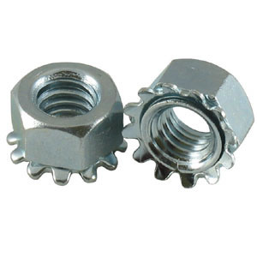
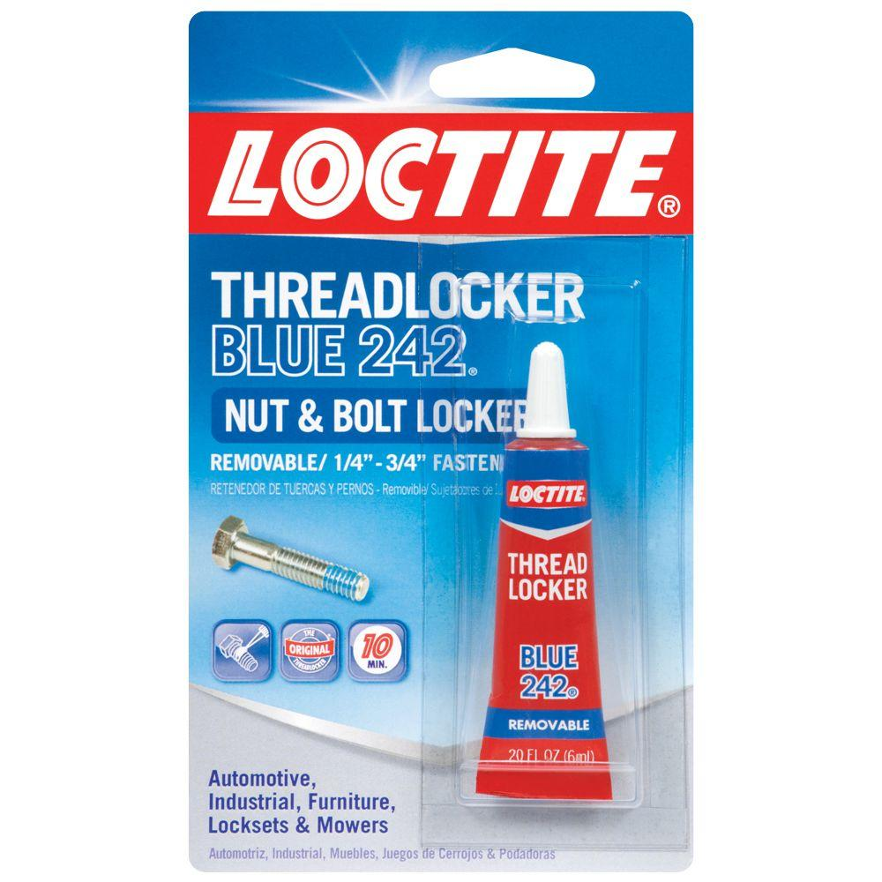
More Mechanical Build Tips
Fasteners (2)
Kep Nuts go in the trash! (talking to you Tetrix)
Use thread lock on any bolts/nuts w/o nylon lock nut (e.g. LocTite)
Use the blue “removable” kind
Note “blue” LocTite comes in a red tube and “red” LocTite comes in a blue tube???

Slide 18
Live Axles -- Caution!
Live Axle – the Axle spins with the wheel/gear/pulley/sprocket
Axle is transmitting torque
Set screws in this application are “bad”
Consider D-shaft, hex shaft etc.
Tetrix shaft is VERY soft. Avoid Live Axle designs where possible! Actobotics D-shaft is better
USUALLY better to avoid Live Axle designs unless using hex shaft

Slide 19
Examples of Good Live Axle Design (Uses Hex Shaft!)
https://www.vexrobotics.com/vexpro/ftc/new-for-2018-19/versachassis-mini.html

Slide 20
Dead Axles -- Recommended where they make sense
Dead Axle – the Axle is stationary and the wheel/pulley/sprocket(s) turn on the axle
Axle is NOT transmitting torque
Screw gear/pulley/sprocket direct to wheel
Spacers on axle better than set screws
Consider clamping shaft collars

Slide 21
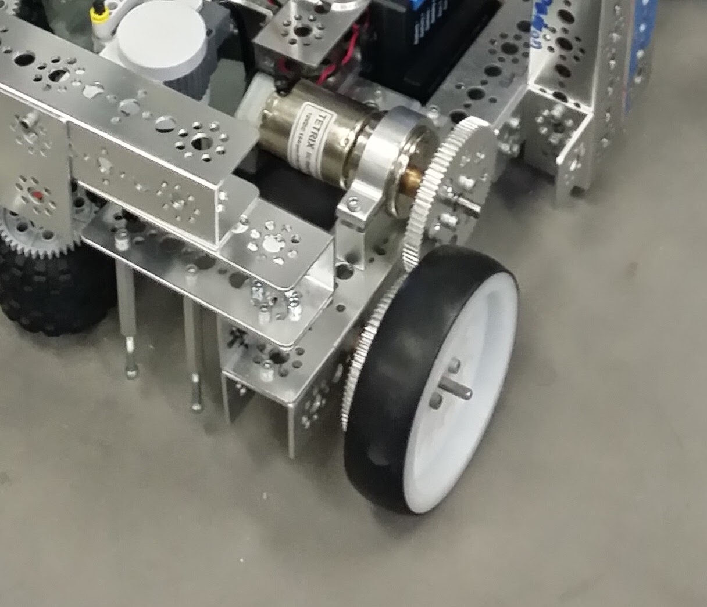
Simple Tetrix Dead Axle Design

Slide 22
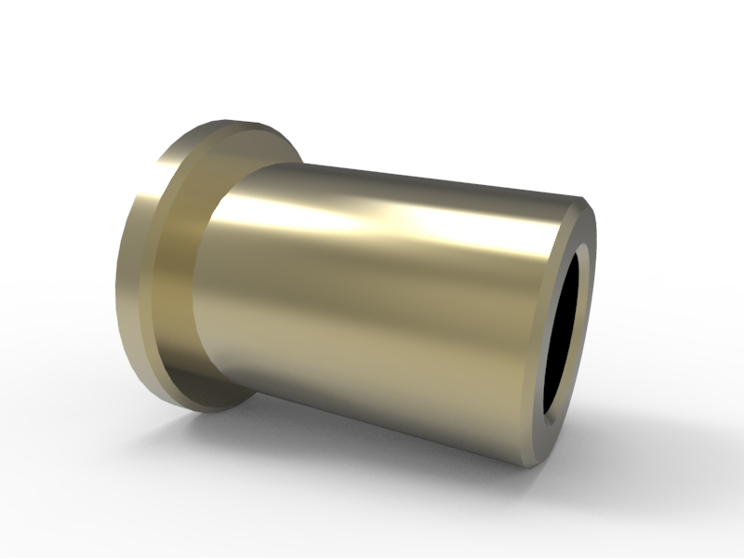
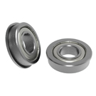
Sleeves, Bushings & Bearings – Oh My
Need to reduce friction at points of rotations
Bushings/sleeves smaller and lighter but not as efficient (e.g. Tetrix)
Bearings are great – but more costly, heavier, larger (e.g. Actobotics)
Exactly 2 bearings/bushings on any axle!
Tetrix Bushing
Ball Bearings

Slide 23
COTS Shaft Thoughts & Comments
TETRIX MAX
Motor Shafts 6mm D shaft -- strong
Axles 3/16” D shaft. Soft stainless steel alloy. Prone to twist under high load, bronze bushings through frame is the common bearing. Easy to bend/etch grooves.
Some teams grind a flat on to 4041 steel rod.
REV Robotics
Motor shafts and axles are all 5mm hex. Delrin bearings with mounts for 19mm extrusion channel.
AndyMark
6mm D motor shafts and axles. Flanged 6mm bearings.
New “NUB” system to connect to wheels and gears.
Actobotics
large variety of options. They have a complete system of adapters to match the TETRIX MAX products
D shafts much harder than Tetrix
VEXPro – 3/8” or ½” hex shaft to build like FRC

Slide 24
Protect Your Servos w/ ServoBlocks
https://www.servocity.com/servos/servoblocks

Slide 25
Mix & Match Build Systems is OK
Suppliers provide hole pattern adapters / axle adapters
Examples:
Vex D Shaft Adapter Hubs
Actobotics Pattern Adapters
Shaft Adapters
Custom (i.e. drill your own holes)

Slide 26
Wiring Tips
Strain relief on ALL cables
Especially USB cables (especially microUSB)
This is a MAJOR issue with Modern Robotics control systems
Cable management is not JUST about appearance
Neat cabling easier to troubleshoot
Loose cables flopping around can cause issues
Many CAD models on Internet for cable strain relief on common FTC components
Zip ties work fine
Some teams use “hot glue” or even superglue! Not sure I recommend.

Slide 27
Electronics Placement
Main power switch accessible to field staff BUT
Can’t be accidently hit by another bot or field element during match!
Properly labeled
It is REQUIRED!
Phone should be accessible to field stuff for troubleshooting BUT
Protect the screen against impact/breakage where possible
Ability to use external USB video cameras this year helps!
Keep cable runs short and neat when possible

Slide 28
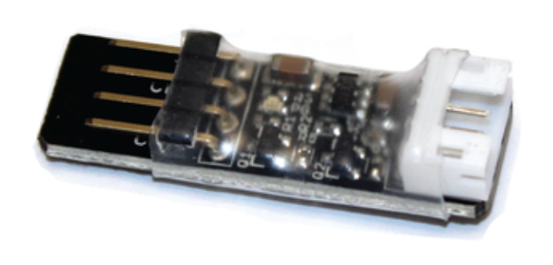
Watch your sensor voltages
Many legacy (e.g. Modern Robotics) sensors use 5v
Rev Expansion Hub is based on 3.3v sensors
Rev logic level converter often required
http://www.revrobotics.com/rev-31-1389/ -- $3 each
Rev Expansion Hub Getting Started Guide sec 4.4: https://www.revrobotics.com/content/docs/REV-31-1153-GS.pdf

Slide 29
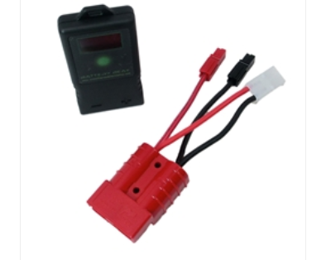
Batteries – How Many Do I Need?
Ideally you use a fully charged battery for every match!
Realistically you can get 2-3 matches per battery depending on your robot
You “should” bring a minimum of 3-4 batteries to competition with enough chargers to keep them topped off
Measure your batteries – don’t guess
Ideally with a “load tester” e.g. AndyMark/CTRE Battery Beak ($91 for FTC version w/ adapter cable)
https://www.andymark.com/battery-beak-p/am-batterybeak.htm

Slide 30
2018-2019 Game Manual Part 1
Section 8 – The Robot
A FIRST Tech Challenge Robot is a remotely operated vehicle designed and built by a registered FIRST Tech Challenge Team to perform specific tasks when competing in the annual game challenge. This section provides rules and requirements for the design and construction of a Robot. Teams should be familiar with the Robot and game rules before beginning Robot design.
Section 9 – Robot Inspection
The FIRST Tech Challenge Robot will be required to pass Robot and Field inspections before being cleared to compete. These inspections will ensure that all Robot rules and regulations are met. Initial inspections will take place during Team check-in/practice time.

Slide 31
Robot Systems
Drivetrain – many types
Chassis – <= 18x18x18 in starting configuration
Electronics / Control System
Robot Electronics
Drive Station
Manipulators (very game specific)
Intakes
Game Element Movement/Storage
Grippers
Lifts / Extensions
Shooters
Flywheel (think baseball pitching machine)
Catapult
Pusher / puncher

Slide 32
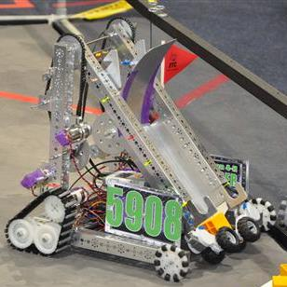
Robot Mechanical Components

Slide 33
<RG01> Illegal Parts
Drive system parts that can damage field
Parts that can damage or flip other robots
Containing hazardous materials
Posing uneccary entaglement risks
Sharp edges or corners
Animal product based materials
Containing liquid or gel materials.
Containing materials that would cause a delay of game if released (for example, loose ball bearings, coffee beans, etc.).
Parts designed to electrically ground the Robot frame to the Playing Field.
Closed gas devices (gas storage vessel, gas spring, compressors, etc.). k.
Hydraulic devices.

Slide 34
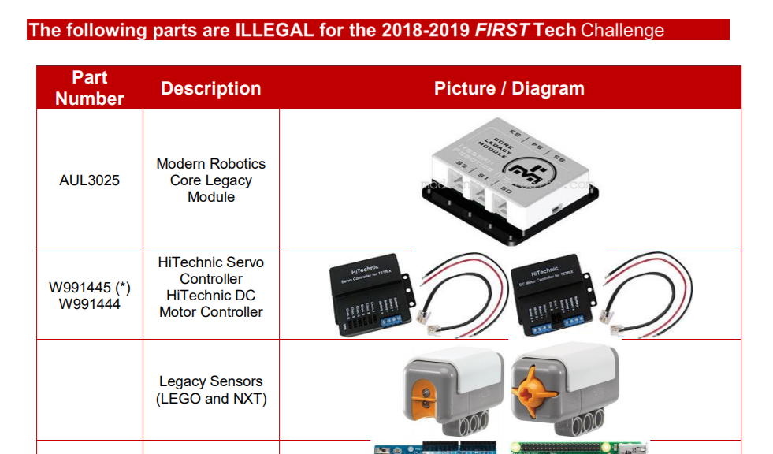
<RG01> Illegal Parts
FIRST publishes a document listing legal and illegal parts. Not all parts, legal or illegal, are in this document. It is only a reference with some common items. Game Manual(s), Q&A, and lead robot inspectors are the final authority!
https://www.firstinspires.org/sites/default/files/uploads/resource_library/ftc/legal-illegal-parts-list.pdf

Slide 35
<RG04> Maximum Robot Weight
New for 2018-2019 Season!
Robots must not weigh more than 42 pounds including battery. To account for variances between scales, there will be a .5 pound (.23kg) overage allowance on top of the 42 pound weight limit. This weight constraint does not include the Alliance Flag or Team Marker. If a Team is using multiple mechanisms that will be swapped out from one match to the next, all components and the robot must be weighed together during weight inspection and must not weigh more than 42 pounds.
Some past year robots have exceeded this weight limit!

Slide 36
<RE01> Main Power Switch
The Robot Main Power Switch must control all power provided by the Robot main battery pack. FIRST requires Teams to use either the TETRIX (part # W39129), MATRIX (part # 50- 0030), or REV (REV-31-1387) power switch. This is the safest method for Teams and field personnel to shut down a Robot.
The Robot main power switch MUST be mounted or positioned to be readily accessible and visible to competition personnel. A Main Robot Power label must be placed near the Main Power Switch of the Robot. Attach the image (“POWER BUTTON”) to your Robot near the Main Power Switch.

Slide 37
Batteries
<RE03> -- Battery Mount - Batteries MUST be securely attached (for example, VELCRO, zip tie, rubber band) to the Robot in a location where they will not make direct contact with other Robots or the Playing Field.
<RE04> -- Robot Main Battery – All Robot power is provided by a single 12 V Robot main battery. The only allowed Robot main power battery packs are:
a. TETRIX (W39057, formally 739023) 12 VDC battery pack
b. Modern Robotics/MATRIX (14-0014) 12 VDC battery pack
c. REV Robotics (REV-31-1302) 12 VDC Slim Battery pack

Slide 38
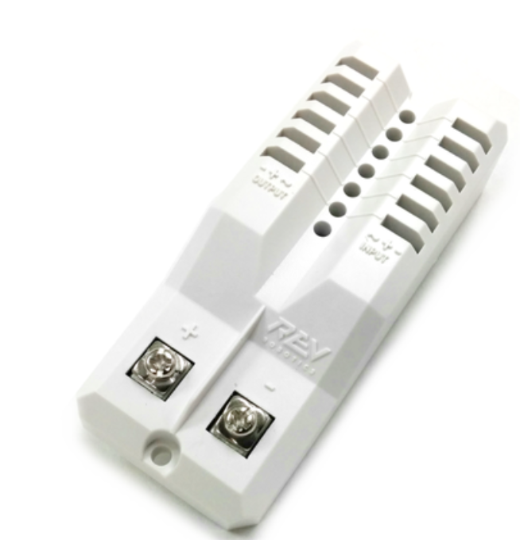
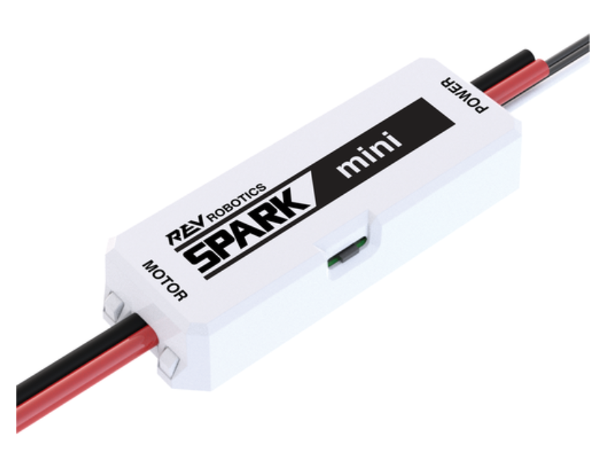
<RE08> Motor and Servo Controllers
Motor and Servo Controllers are allowed in the following configuration.
Modern Robotics Core Motor Controllers,
Modern Robotics Core Servo Controllers,
REV Expansion Hub,
REV Servo Power Module
and REV SPARK Mini Motor Controllers
in any combination.
REV Servo Power Module
REV Spark Mini Motor Controller

Slide 39
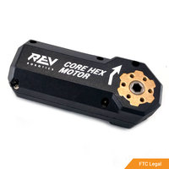
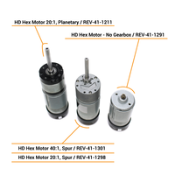
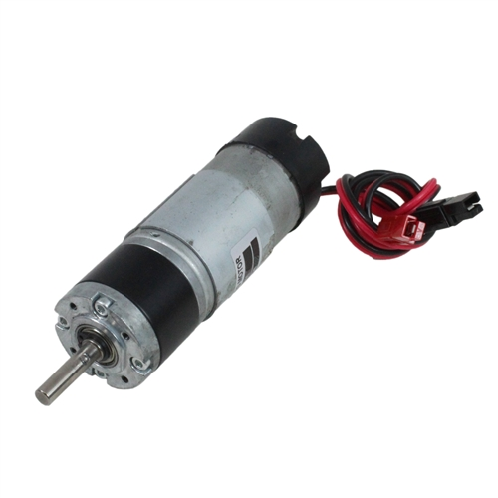
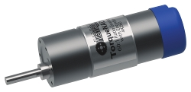
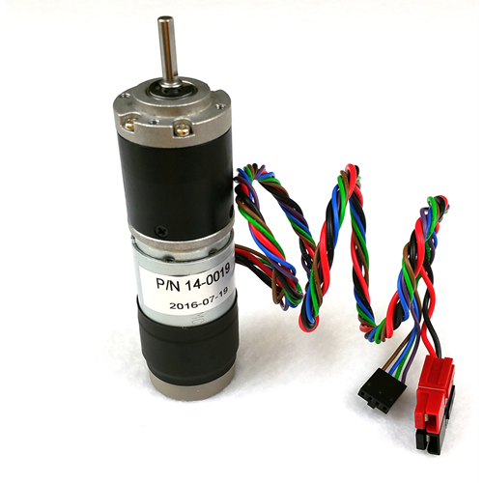
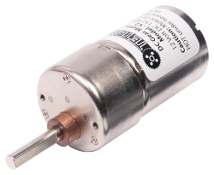
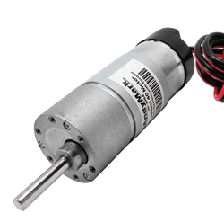
<RE09> DC Motors
A maximum of eight (8) DC motors are allowed. The only allowed motors are:
TETRIX 12V DC Motor – not recommended
AndyMark NeveRest series 12V DC Motors
Modern Robotics/MATRIX 12V DC Motors
REV Robotics HD Hex 12V DC Motor
REV Robotics Core Hex 12V DC Motor

Slide 40
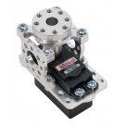
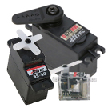
<RE10> Servos
A maximum of twelve (12) servos are allowed. Any servo that is compatible with the attached servo controller is allowed. Servos may only be controlled and powered by an allowed Servo Controller, REV Expansion Hub or REV Servo Power Module (when used with an allowed Servo Controller or REV Expansion Hub). Servos may be rotary or linear but are limited to 6V or less and must have the three-wire servo connector.

Slide 41
<RE11> Sensors
Sensors are subject to the following constraints:
Compatible sensors from any manufacturer may be connected to the Core Device Interface Module or REV Expansion Hub.
Compatible sensors from any manufacturer may be connected to the Logic Level Converter and/or the I 2C Sensor Adapter Cable.
Passive electronics may be used as recommended by sensor manufacturers at the interfaces to the sensors.
Voltage sensors are allowed; except on an output port of a motor or servo controller.
Current sensors are allowed; except on an output port of a motor or servo controller
Simple I2C multiplexers are allowed and they may only be connected to and powered from the I2C connections available on the Core Device Interface Module or the REV Expansion Hub
Voltage and/or current sensors are also allowed to connect between the battery pack and the REV Expansion Hub or Core Power Distribution Module.

Slide 42
<RE11> Sensors Examples
Voltage/current sensors (limited locations!)
Distance Sensors
Color Sensors
Analog Potentiometer
Touch Sensor
Limit Switch (Mechanical or Magnetic)
Encoders – Built into motors or stand alone
Absolute
Relative
Many brands – pretty much anything that is compatible is legal
Interfacing to Rev Hub may require voltage converter: http://www.revrobotics.com/content/docs/REV-31-1153-GS.pdf

Slide 43
<RE11> Sensors Built into Rev Hub
Battery Voltage sensor (new last year – not many knew about)
Integrated 9 axis Inertial Measurement Unit (aka Gyro)
Absolute orientation in 3 dimensions – most commonly used
Rate of rotation in 3 dimensions
Acceleration in 3 dimensions (including finding earth’s gravity which tells us which way is down)
Magnetometer (aka compass) – almost useless on metal robot with motors etc.
Current Monitoring sensor (not yet exposed in software library)
Total
Per motor
Per device bus (servo, I2C, etc)

Slide 44
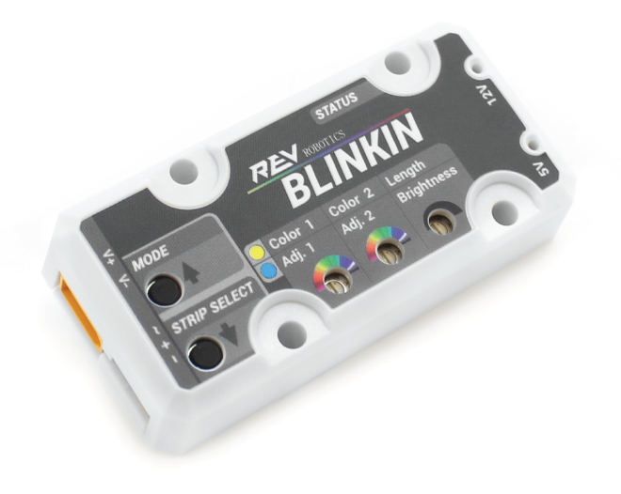
<RE12> Light Sources (New Options)
Functional and/or decorative light sources (including LEDs) are allowed with the following constraints:
Focused or directed light sources (for example: lasers and mirrors) are not allowed except for the REV Robotics 2m Distance sensor (REV-31-1505).
Light source control by compatible ports on the REV Expansion Hub and Modern Robotics Core Control Modules is allowed.
Commercial off the Shelf interface modules (without user programmable microprocessors) are allowed between the light source and the components listed in b. (e.g NEW Rev Blinkin)
The only approved power sources for lights are as follows:
Internal (as supplied by the Commercial off the Shelf manufacturer), battery pack or battery holder
Power ports on the Core Power Distribution Module
Motor-control ports on the Core Motor Controller Module
REV Expansion Hub Motor-control ports, spare XT30 ports, 5V auxiliary power ports, and I2C sensor ports.
http://www.revrobotics.com/content/docs/REV-31-1153-GS.pdf

Slide 45
<RE06> Android Devices <RE16> Driver Station
Specific list of legal Android Phones
Exactly 1 phone on robot, 1 on driver station
On robot phone, only internal battery or powered by robot battery (e.g. via Rev Hub)
On Driver Station 1 USB battery allowed
Driver Station
Phone
One OTG cable
<= 1 USB Hub
2 Gamepads (Logitech F310 or Xbox 360)

Slide 46
Q&A
Feel free to contact me after the event w/ questions: mike@sonnier.name
I will likely be volunteering again this year in some manner as FTA/CSA/robot inspector for at least some events in Louisiana. As I get updates/training from FIRST headquarters I will work w/ Clark and FIRST Louisiana to get updates out to teams.

